Slide 1
CHAPTER 3
DERIVATIVES

Slide 2
CONTENTS
3.1. Derivatives
3.2. Derivative as a Function
3.3. Differentiation Formulae
3.4. Rates of Change in the Natural and Social Sciences
3.5. Derivatives of Trigonometric Functions
3.6. The Chain Rule
3.7. Implicit Differentiation
3.8. Derivatives of Logarithmic Functions
3.9. Related Rates
3.10. Linear Approximations and Differentials

Slide 3
3.1 DERIVATIVES
3.1.1. Definition of Derivatives
3.1.2. The Derivative as the Slope of a Tangent
3.1.3. The Derivative as Rate of Change

Slide 4
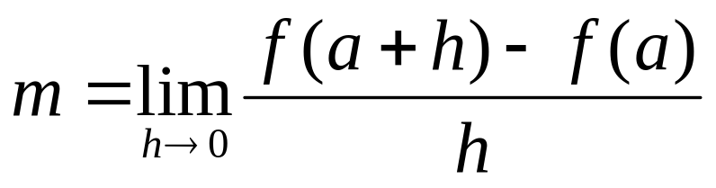
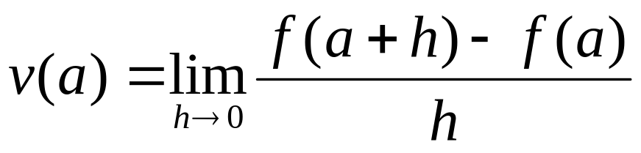
3.1.1 Definition of Derivatives
Recall that the slope of the tangent of a curve y=f(x) at the point (a,f(a)) is defined by
Similarly the instantaneous velocity of an object with position function y=f(t) at time t is defined by

Slide 5
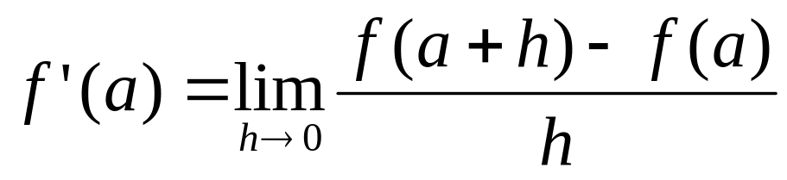
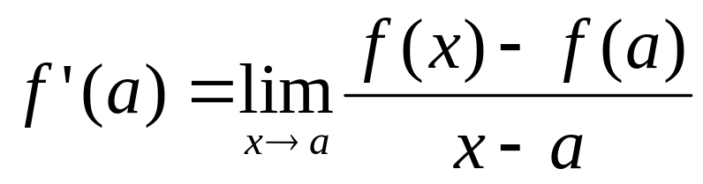
Definition . The derivative of a function at the number a, denoted by f’(a) , is
if the limit exists
Note that the derivative may also be defined by

Slide 6
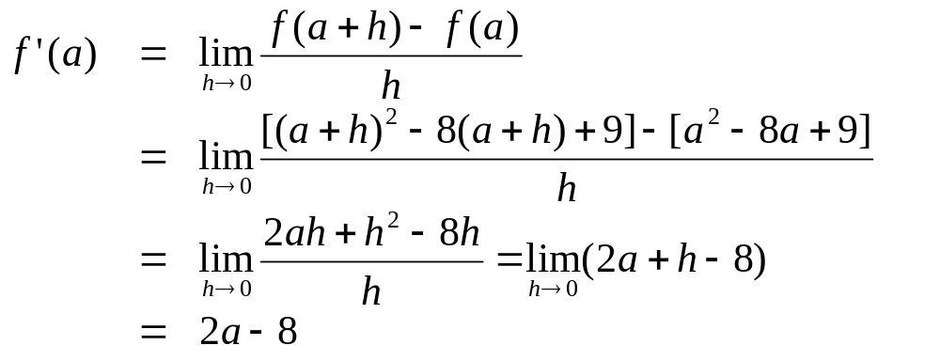
Example. Find the derivative of the function f(x)=x²-8x+9 at the number a
Solution. We have

Slide 7
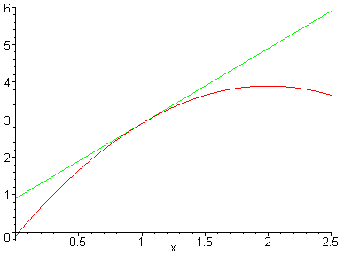
3.1.2 The Derivative as the Slope of a Tangent
t
P
The slope of the tangent t to the curve y=f(x) at (a,f(a)) is the derivative f ’(a)

Slide 8
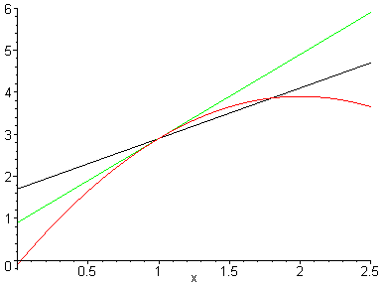
t
Q
f(x)-f(a)
P
x-a
The equation of the tangent at the point (a,f(a))
y – f(a) = f ’(a)(x – a)

Slide 9
Example. Find the equation of the tangent line to the parabola y = x² – 8x + 9 at the point P(3,-6)
Solution. The slope of the tangent at P is
m = f’(3) = 2×3 - 8 = -2
Therefore the equation of the tangent line at P is
y – (–6) = –2(x – 3)
or y = –2x

Slide 10
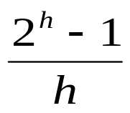
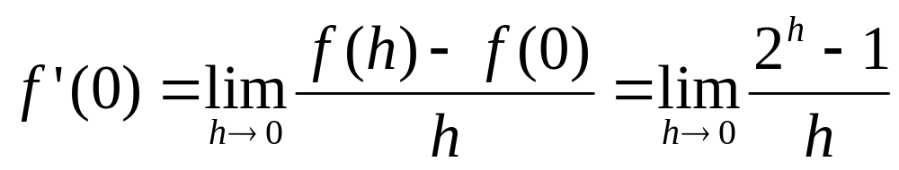
Example. Let y = 2^{x} . Evaluate f ‘(0) in two ways
(a) By using Definition 2 and a table of values
h
0.1 | 0.178
0.01 | 0.696
0.001 | 0.693
0.0001 | 0.693
-0.1 | 0.670
-0.01 | 0.691
-0.001 | 0.693
-0.0001 | 0.693
Solution. (a) By Definition 2 we have
From the table we can estimate
f ‘(0) ≈ 0.69

Slide 11
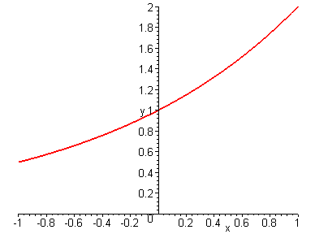
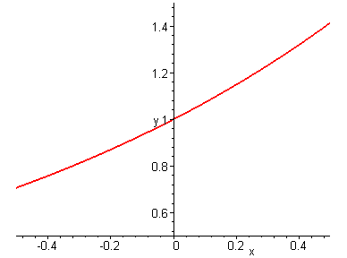
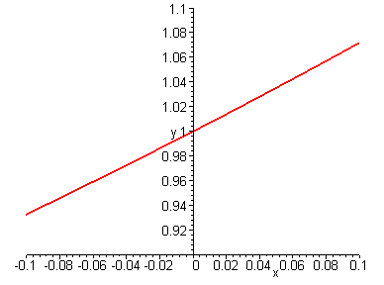
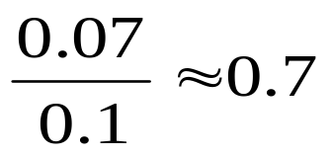
(b) By graphing the curve y = 2^{x}
By zooming in smaller and smaller rectangles, the curve is close to a line.
The slope of the line is an approximation for f’(0)

Slide 12
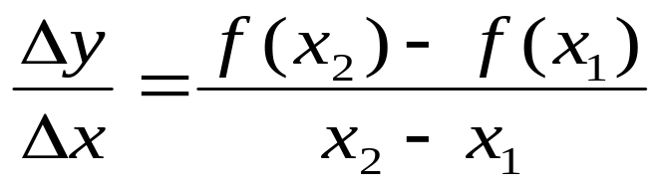
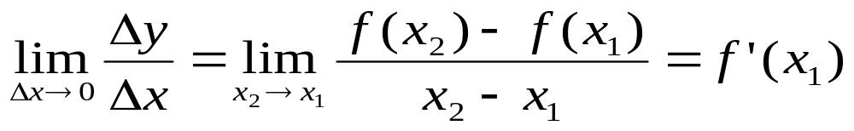
3.1.3 The Derivative as the Rate of Change
Let y=f(x) , then the average rate of change of y with respect to x over the interval [x₁, x₂] is defined by,
The instantaneous rate of change of y with respect to x is defined as

Slide 13
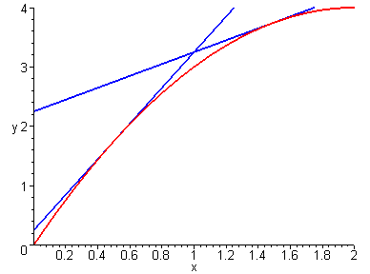
When we sketch the curve y = f(x), the instantaneous rate of change of y with respect to x at a is f’(a). Therefore
when ⎪f’(a)⎪is large, the y values change rapidly
when ⎪f’(a)⎪is small, the y values change slowly
In particular when s = f(t) is the position function of a particle, then f’(a) is its instantaneous velocity at a

Slide 14
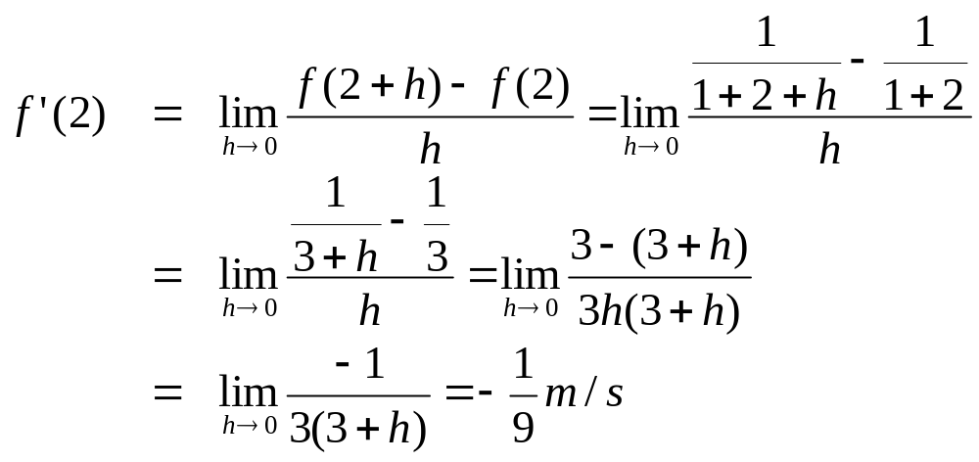
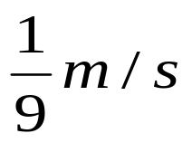
Example. The position of a particle is given by s=f(t) =1/(1+t). Find the velocity and speed after 2 seconds
Solution. The velocity after 2 seconds is
The speed after 2 seconds is

Slide 15
Example. The cost of producing x yards of a fabric is C = f(x) dollars
What is the meaning of f ‘(x) ?
What does it mean to say f ‘(1000) = 9 ?
Which one is greater among f ‘(50) and f ‘(500) ?
Solution. (a) f ‘(x) is the rate of change of the production cost with respect to the number of yards produced (the marginal cost),
and measured in dollars per yard

Slide 16
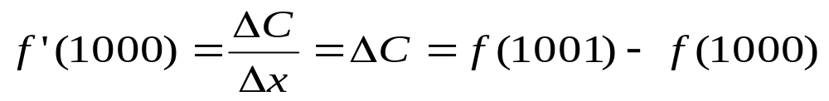
Solution. (b) f ‘(1000) = 9 means that after producing 1000 yards, the rate at which the production cost increases is 9$/yard
Taking Δx = 1, we may approximate f ‘(1000) by
i.e. the cost of producing the 1001st yard is 9$
(c) We may have f ‘(50) > f ‘(500) because of economies of scale

Slide 17
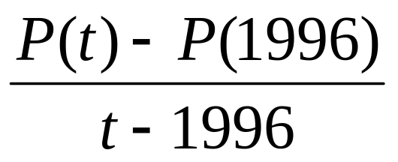
Example. The population of USA is given by the following table. Interpret and estimate P’(1996)
t | P(t)
1992 | 255,002
1994 | 262,292
1996 | 265,253
1998 | 270.002
2000 | 274.634
Solution. P ‘(1996) means the rate of change of population in 1996
We may approximate P ‘(1996) by computing the average rates of change

Slide 18
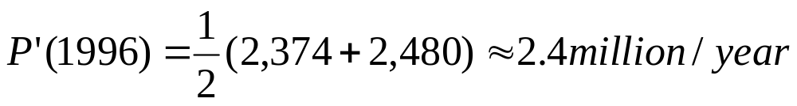
With t=1996 the average rate of change is computed for some intervals in the following table
t
1992 | 2,562.750
1994 | 2,480.500
1998 | 2,374.500
2000 | 2,345.250
r=P’(1996) satisfies:
2,374 ≤ r ≤ 2,480
We can approximate it by the average value:

